Slide 1
ASSIGNMENT #8
VERSION CONTROL
Don McNeish
Maciek Siemczyk

Slide 2
Version Control
Also know as:
Revision control
Source control
Source Code Management (SCM)

Slide 3
What is it?
Any practice that tracks and provides control over changes to source code.
In its simplest form it could just be saving your file with a new name:
hello_world1
hello_world2
Version control systems (VSC) would provide the revision number, timestamp and person making the change

Slide 4
Purpose of Version Control
To manage the changes to documents, programs, or any other computer file containing information
Allows a team of people to make changes to the same file(s)
Necessary in software development in a multi-developer environment

Slide 5
Why use a Version Control System?
Backup and Restore - bring back an old version
Synchronization – share and stay up-to-date
Short-term undo – throw away, get new copy
Find a bug – go back to previous changes
Track changes – leave message about changes
Track ownership – know who changed code
Sandboxing – make changes then “check in”
Branching and merging – separate copy

Slide 6
How is it used?
It is used differently, depending on the client application.
Because svn and cvs are both Open Source, the official clients are just one of many available options when using “svn” or “cvs”.
What ever system is used there is a basic setup and there are basic actions used.

Slide 7
Basic Setup
Repository (repo)
The database storing the files
Server
The computer storing the repo
Client
The computer connecting to the repo
Working Copy
Your local directory of files
Trunk
The “primary” location for code in the repo

Slide 8
Basic Actions
Add – put a new file into the repo
Check out – download a file from the repo
Check in – upload a file to the repo
Checkin Message – say why it was changed
Update – refresh your files with latest changes
Revert – throw away your change (get latest)

Slide 9
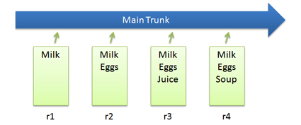
Basic Checkins
In Subversion you would use these commands:
svn add list.txt (Add a file to the repo)
..modify the file..
svn ci list.txt -m “Changed the list” (Check in a file with message)

Slide 10
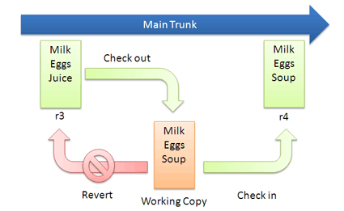
Checkout and Revert
svn co list.txt (get latest version)
...edit file...
svn revert list.txt (throw away changes)
svn co -r2 list.txt (check out particular version)

Slide 11
What’s available?
SVN (Subversion)
CVS
Source Safe (by Microsoft)
Git
Other less popular solutions

Slide 12
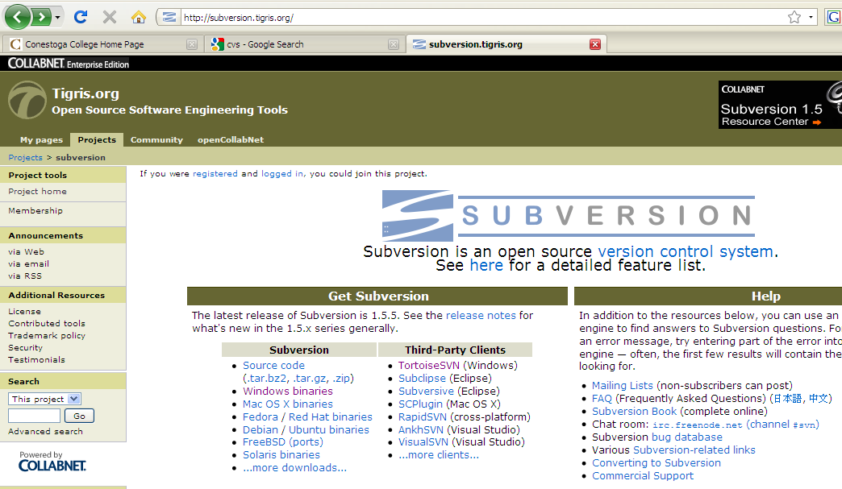
Subversion
Available for download at http://subversion.tigris.org/

Slide 13
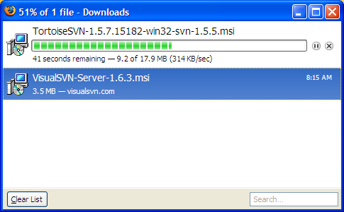
Download
Ben decided to install VisualSVN for the server.
And TortoiseSVN for the client.
He also provided all of these wonderful screen shots

Slide 14
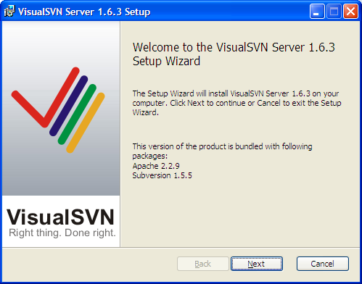
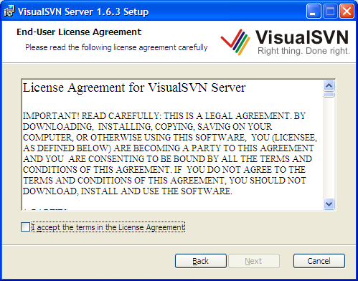
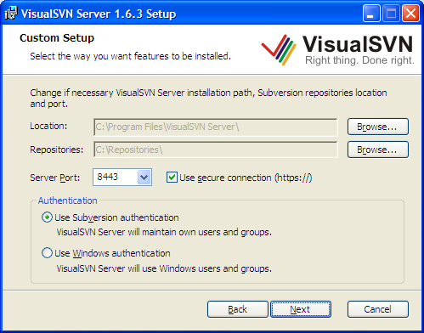
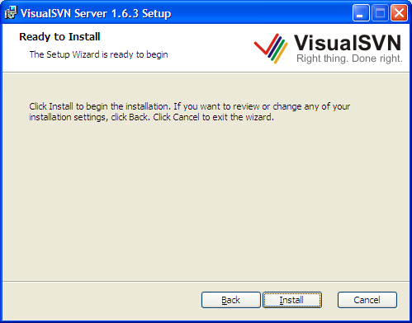

Slide 15
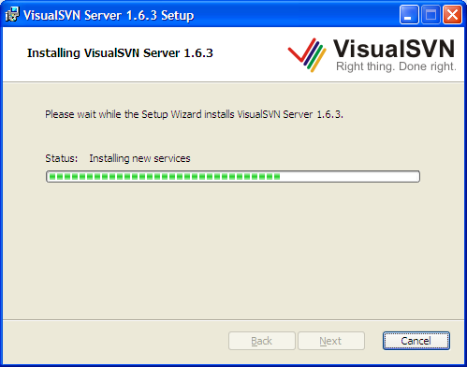
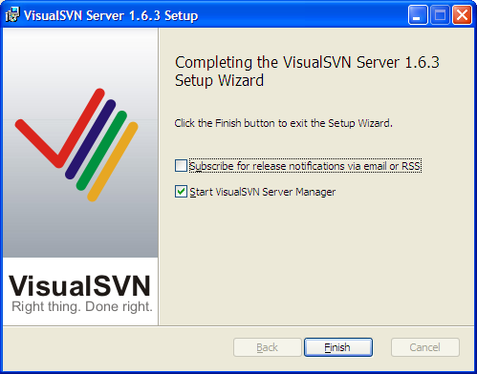

Slide 16
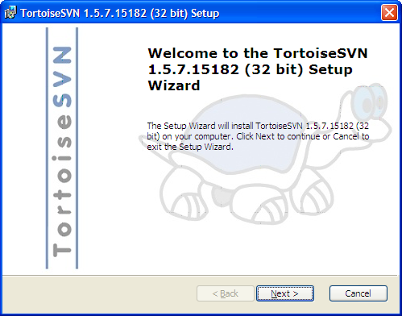
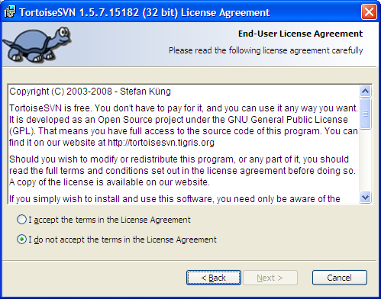

Slide 17
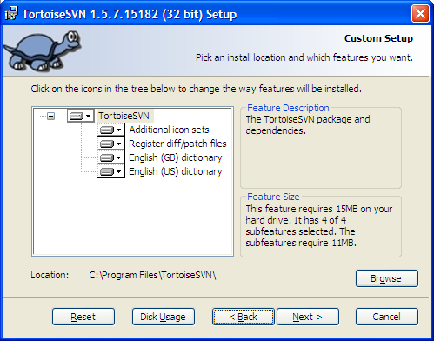
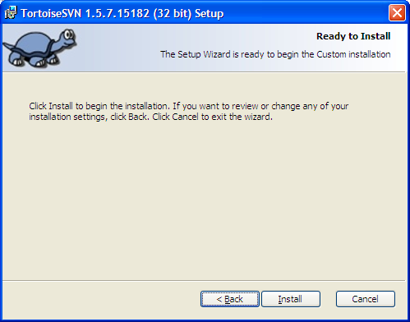

Slide 18
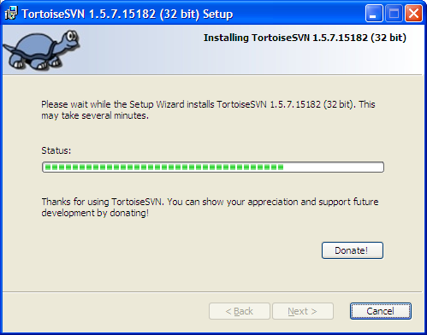
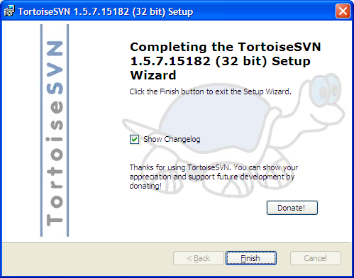

Slide 19
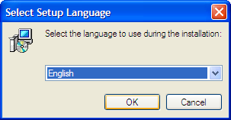
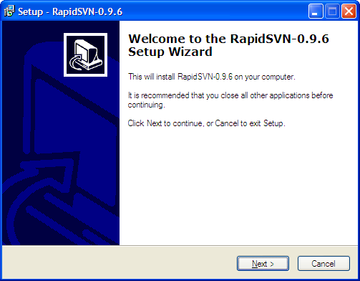
RapidSVN

Slide 20
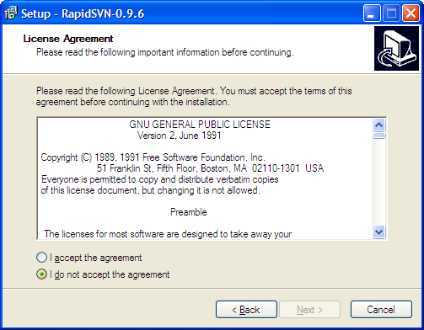
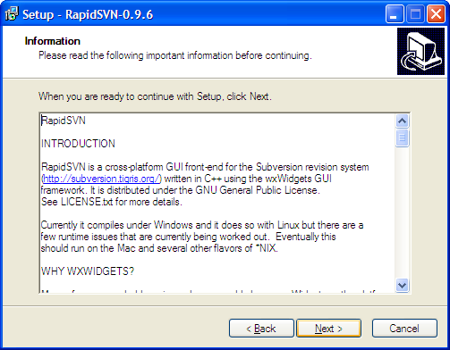

Slide 21
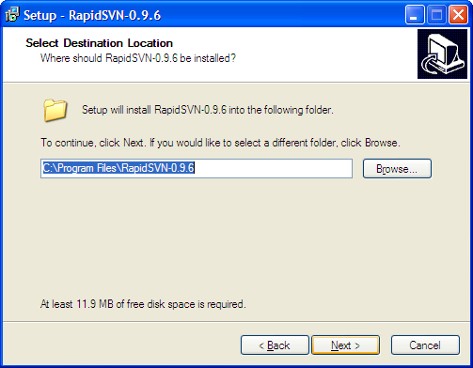
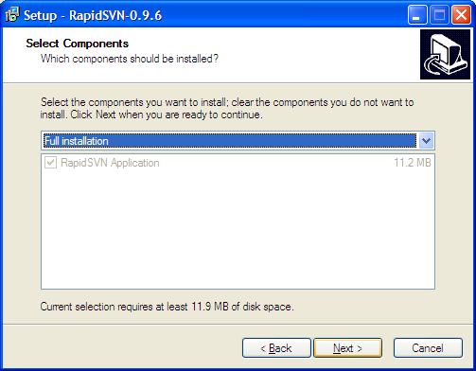

Slide 22
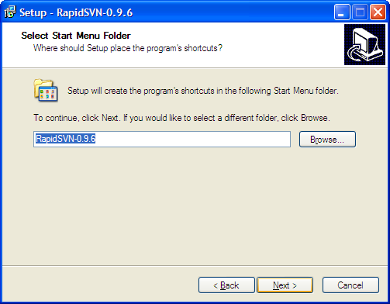
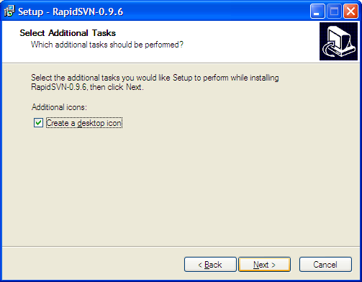

Slide 23
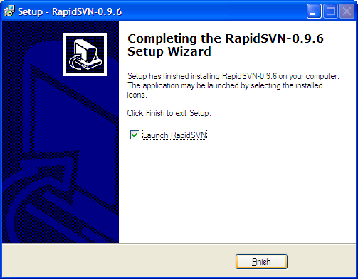
RapidSVN

Slide 24
CVS (Concurrent Versions System)
Available for download at
http://www.nongnu.org/cvs/

Slide 25
Git
Available for download at
http://git-scm.com/

Slide 26
Questions

